Slide 1
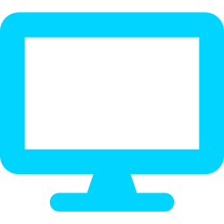


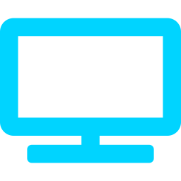

CLOUD COMPUTING
Desktop
Laptop
Desktop Virtualization
Presented By: Akshay Bagde
Subject: Cloud Computing
College: JD College of Engineering & Management
Cloud Server
Tablet
Phone

Slide 2


Introduction to Cloud Computing
Cloud computing: delivery of computing resources over the internet
Resources: servers, storage, networking, databases and software
Benefits: scalability, flexibility and cost efficiency
Laptop
Smartphone
Cloud
Popular providers
AWS
Microsoft Azure
Google Cloud
Servers
Databases

Slide 3
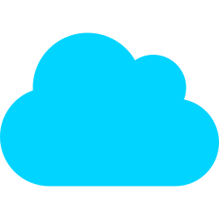
What is Desktop Virtualization?
Separates the desktop environment from the physical device
Hosts desktops on central servers or cloud
Remote access from almost any device
Centralized management of apps and user data
Internet
Your Laptop
(shows the screen)
Cloud Server
(runs the desktop)
Virtual Desktop
OS, apps and data live on the server. The device only displays the output.
Real-life example
Open your college lab desktop from home on your own laptop. Same files, same apps.

Slide 4
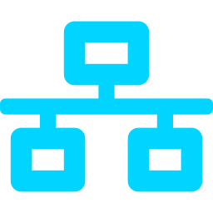
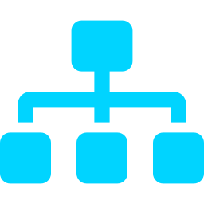
How Desktop Virtualization Works
Client Device
Network
Connection Broker
Virtual Machine
Display Output
INPUT: keyboard and mouse commands
OUTPUT: screen image sent back
1
Desktop created on server
2
OS and apps run virtually
3
User connects from a device
4
Inputs sent to the server
5
Screen output sent back

Slide 5

Types of Desktop Virtualization
VDI
DaaS
RDS
Local
Virtual Desktop Infrastructure
Desktop as a Service
Remote Desktop Services
Local Desktop Virtualization
Each user gets a dedicated VM on company servers.
A cloud provider hosts and manages the desktops.
Many users share one server OS through sessions.
A hypervisor on your own PC runs guest desktops.

Slide 6
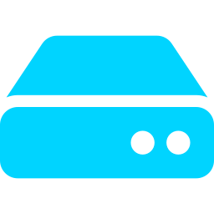
Virtual Desktop Infrastructure (VDI)
Centralized virtual desktop hosting
One VM per user
Hypervisor manages the VMs
Admins control everything centrally
Remote desktop access
Client Devices
Connection Broker
Hypervisor
VM 1
VM 2
VM 3
Storage System

Slide 7
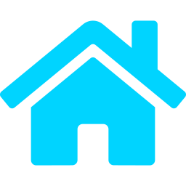

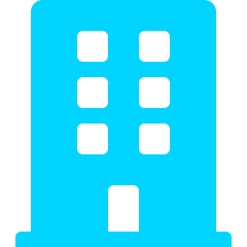
Desktop as a Service (DaaS)
Cloud-hosted virtual desktops
Provider manages the infrastructure
Pricing by subscription or usage
Access over the internet
Less infrastructure maintenance
Home
Campus
Provider Cloud
Examples
Amazon WorkSpaces
Azure Virtual Desktop
Citrix DaaS
Office
Mobile

Slide 8

Key Components of Desktop Virtualization
1. Hypervisor
2. Virtual Machines
3. Connection Broker
Creates and manages virtual machines.
Provide independent desktop environments.
Connects users to their assigned desktops.
4. Storage
5. Network
6. Client Device
Stores operating systems, applications and user data.
Enables communication between client and server.
Gives the user access to the virtual desktop.

Slide 9

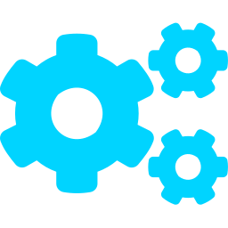




Benefits of Desktop Virtualization
Cost Reduction
Centralized Management
Remote Accessibility
Less hardware spending and lower upkeep.
Update and manage desktops from one place.
Work from anywhere with internet.
Scalability
Data Security
Flexibility
Add or remove desktops as needed.
Data stays on central servers, not devices.
Use many devices with the same desktop.

Slide 10






Challenges and Limitations
Internet Dependency
Initial Setup Cost
Network Latency
A stable connection is needed to work.
Servers and licenses need upfront investment.
Slow networks make the desktop laggy.
Security Risks
Resource Management
Technical Complexity
Central servers become a target to protect.
Shared CPU, RAM and storage must be balanced.
Needs skilled staff to design and maintain.

Slide 11
Desktop Virtualization vs Traditional Desktop
Traditional: OS, apps and data on one local PC
Virtual: desktop runs on a server, any device shows it
Traditional Desktop | Virtual Desktop
Runs on physical hardware | Runs on virtual infrastructure
Local data storage | Centralized storage possible
Limited remote access | Remote access supported
Individual maintenance | Centralized management
Hardware upgrades needed | Resources can be scaled
Device-dependent | Device-independent access

Slide 12



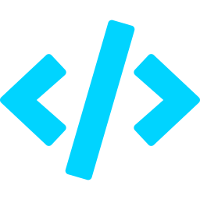

Applications of Desktop Virtualization
Education
Business
Healthcare
Virtual computer labs for students.
Remote working environments.
Access to applications across departments.
IT Industry
Banking
Call Centers
Software development and testing.
Centralized desktop management.
Centrally managed employee desktops.

Slide 13
Popular Desktop Virtualization Platforms
Omnissa Horizon
Amazon WorkSpaces
Azure Virtual Desktop
Citrix DaaS
PROVIDER
PROVIDER
PROVIDER
PROVIDER
Omnissa
Amazon Web Services
Microsoft
Citrix
Virtual desktop and app delivery platform.
Managed cloud desktops from AWS.
Cloud-hosted Windows desktops and apps on Azure.
Cloud-delivered virtual apps and desktops.

Slide 14
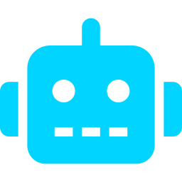
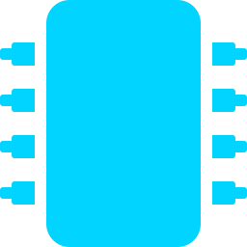



Future Scope of Desktop Virtualization
AI Optimization
Edge Computing
5G Connectivity
Smarter allocation of resources.
Desktops closer to users, lower delay.
Faster, more reliable remote access.
Zero Trust Security
Hybrid Cloud
Automation
Verify every user and device.
Mix on-premises and cloud desktops.
Automatic setup, scaling and updates.
AI
Edge
5G
Cloud
Devices

Slide 15

Conclusion & References
Important technology in cloud computing
Centralized management and remote access
Less hardware dependency
Supports businesses and education
Evolving with AI, 5G and cloud
References
Microsoft Learn: Azure Virtual Desktop
AWS Documentation: Amazon WorkSpaces
Citrix Documentation
Omnissa Documentation
NIST Cloud Computing Resources
THANK YOU!
Questions & Answers

